Slide 1

Forensic Analysis of Free VPNs and DNS/IP Leaks

Slide 2
AGENDA
Introduction to Forensic Analysis on Free VPNs
What is a DNS Leak?
What is an IP Leak?
How to Prevent DNS and IP Leaks
Conclusion

Slide 3
Introduction to Forensic Analysis on Free VPNs
A Virtual Private Network (VPN) is a secure connection that routes your internet traffic through a remote server, allowing you to access the internet privately and securely. Free VPNs are available, however, they come with certain risks. Forensic analysis on free VPNs looks at two areas in particular - DNS leak and IP leak.
DNS leak and IP leak are two of the most common security vulnerabilities of free VPNs. They can both be used to bypass the security measures of a VPN and expose the user’s true IP address and other sensitive data.

Slide 4
What is a DNS Leak?
A DNS leak occurs when a user’s true IP address is exposed through a DNS request. This can happen when a user’s VPN connection is not properly configured, or when the user’s device is not properly secured. When a DNS leak occurs, the user’s true IP address is exposed, making it easier for hackers to track the user’s online activity.
The forensic analysis of a DNS leak involves examining the DNS requests and responses to determine if the user’s true IP address is exposed. This can be done by examining the DNS request and response headers, as well as the DNS records themselves.

Slide 5
What is an IP Leak?
An IP leak occurs when a user’s true IP address is exposed through a web request. This can happen when a user’s VPN connection is not properly configured, or when the user’s device is not properly secured. When an IP leak occurs, the user’s true IP address is exposed, making it easier for hackers to track the user’s online activity.
The forensic analysis of an IP leak involves examining the web requests and responses to determine if the user’s true IP address is exposed. This can be done by examining the web request and response headers, as well as the web records themselves.

Slide 6
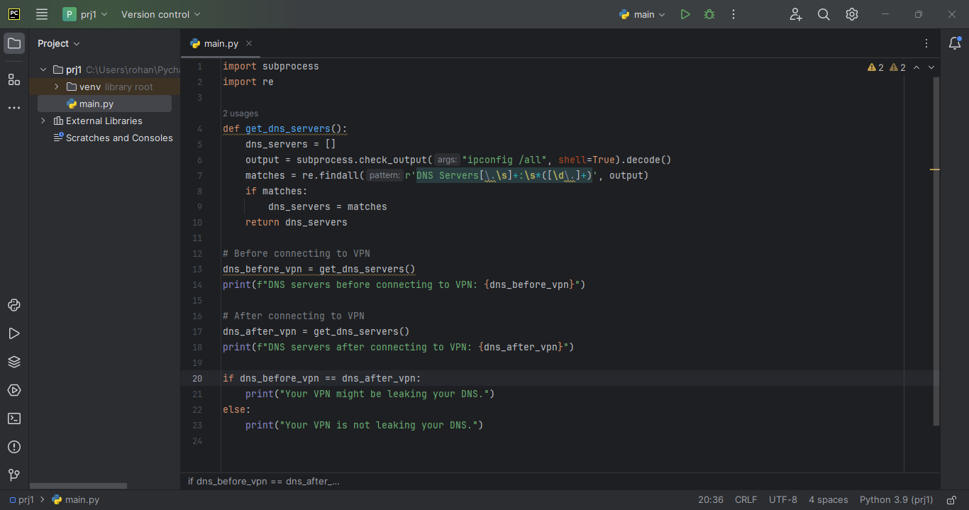
PROGRAM TO CHECK DNS/IP LEAK

Slide 7
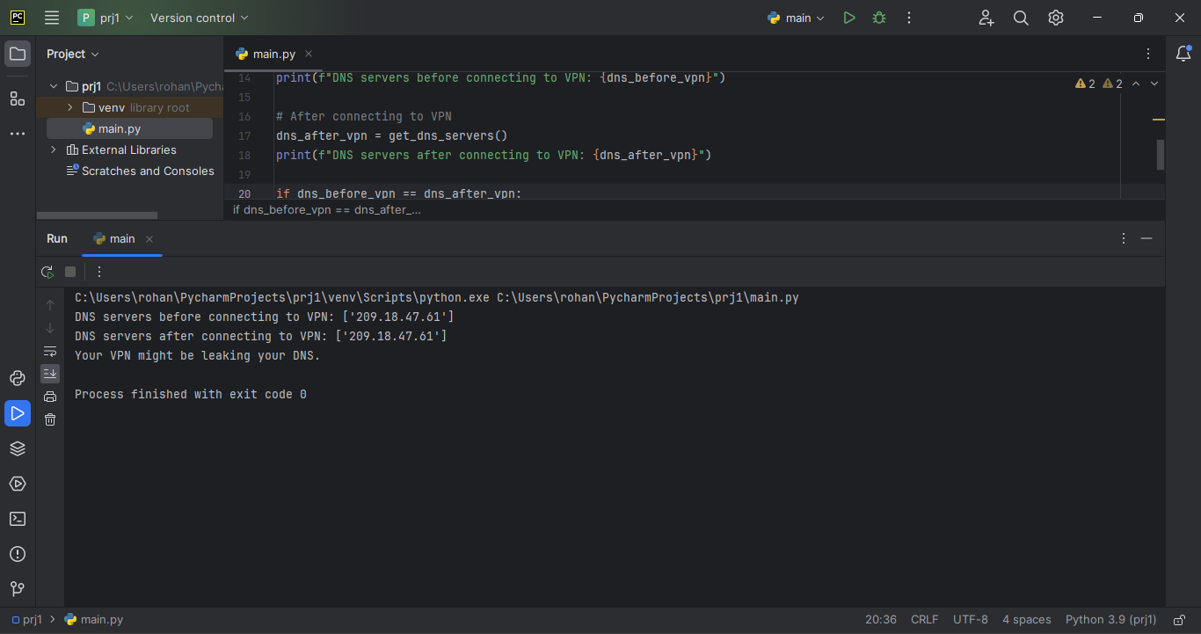
OUTPUT

Slide 8
How to Prevent DNS and IP Leaks
The best way to prevent DNS and IP leaks is to use a reputable VPN provider. Reputable VPN providers have secure connections and use strong encryption protocols to ensure that your data is safe and secure. Additionally, reputable VPN providers will have a “No Logs” policy, which means that they do not store any of your data or activity logs.
It is also important to ensure that your device is secure and that your VPN connection is properly configured. If you are using a free VPN, it is important to make sure that you are using a secure connection and that your device is properly secured.

Slide 9
Conclusion
Forensic analysis on free VPNs is an important part of ensuring that your data and online activity is secure. It is important to understand the risks associated with free VPNs and to take the necessary steps to ensure that your data is secure. By using a reputable VPN provider and ensuring that your device is secure, you can protect yourself from DNS and IP leaks.
It is also important to regularly check for DNS and IP leaks. This can be done using a reputable VPN provider or by using an online tool that can check for DNS and IP leaks. By regularly checking for DNS and IP leaks, you can ensure that your data and online activity is secure.

